Slide 1
ADVISOR: MATTHEW POST
CLIENT: TRUEFORCE TECHNOLOGIES
SDMAY25-10
CONTEXTUALIZATION / DESIGN CHECK-IN
TESSA LANZEL, PAIGE SCHNEIDER, MOLLY ROONEY, MAY EDEL, ELICIA BARANOWSKI, ALEXANDRA RAUER, JOSHUA STEVEN CHIANG

Slide 2
PROBLEM
Unknown knowledge for what weights will improve strength without injuring
Current data is not transferable across devices
No security
Current Application is full of bugs
Availability to users

Slide 3
OVERVIEW
Develop a mobile application for both Google Play Store and Apple App store using their native language
Apps will connect to existing firmware and database to display and store user’s force output for each lift and metrics over a period of time

Slide 4
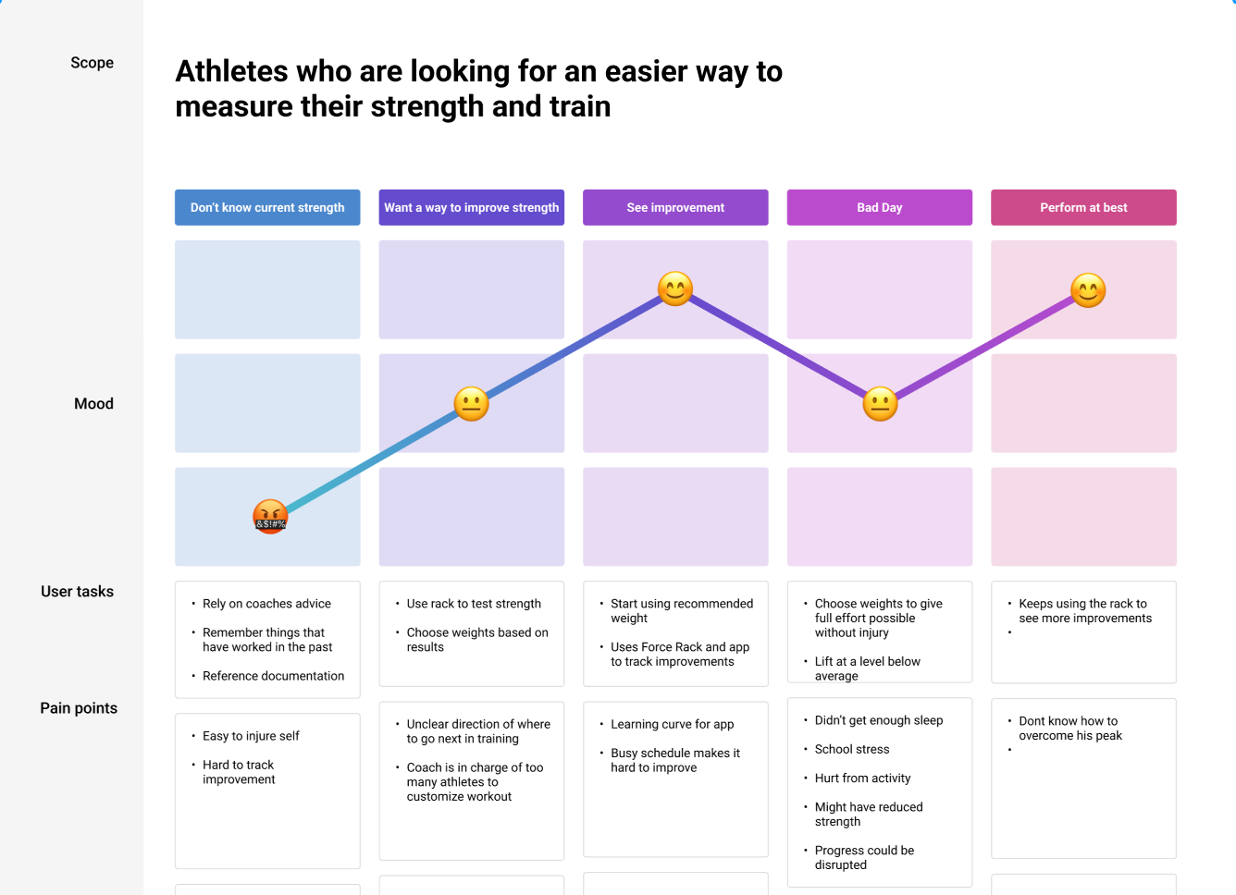
ARTIFACTS - JOURNEY MAP

Slide 5
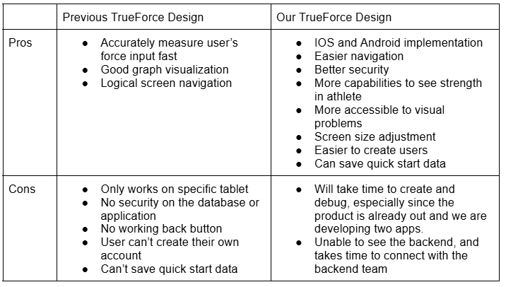
ARTIFACTS - PRO/CONS TABLE

Slide 6
HUMAN
Our current solution addresses specific user needs by:
Receiving feedback from the client
Making changes to the existing product based on feedback
The application is an improvement on a previous design, as we have:
Analyzed the original design
Changed the application flow
Adjusted text coloring in certain areas
Customizing the app for coaches and athletes who will use it
To further improve the solution:
We plan to connect our application to a weight rack in the senior design lab
This setup will allow us to interact with the equipment as a user would, providing a realistic context

Slide 7
ECONOMIC
Existing Solution
Data is shown from a single tablet connected to the Force Rack
Athlete data is available on the tablet or True Force website
Our Solution: Increased mobility and availability
Users can use the application on their own devices
Athlete users can download the app to measure and store their own data
Coaches can easily access their team and athlete data
Drawbacks:
Limited to very few metrics for athlete performance: strength, power
Justification: original intention was to aid in weight lifting for college athletes to gain strength and power
Does not provide direction to what weight to lift from the data
Justification: Original goal was to aid coaches with guidance on lifts and weights based on data

Slide 8
TECHNICAL
Technical complexity analysis:
Independent iOS and android development teams
Unfamiliar with Swift for iOS
Lack of information about established backend and database.
Need graphing widget that can work with live data
Unfamiliar hardware to connect with
Internal technical complexity:
Involves the integration of both hardware and software components
Interconnection between the rack, board, database, and application
External technical complexity:
Demonstrated by the improvements made on an existing technology

Slide 9
CONCLUSIONS
Main Ideas
Using artifacts such as a journey map and pros/cons table to analyze the human, economic, and technical suitability of our solution
Human
Solution addresses user experience for convenience and usability
Economic
Solution improves the mobility and availability of the True Force Technologies software
Technical
Dividing efforts into two groups to implement both iOS and Android
Identifying necessary tasks of integrating our solution with existing hardware and backend/database components

Slide 10
QUESTIONS?

